Slide 1
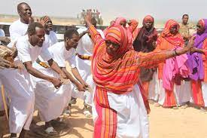
Djibouti
Economic Conditions

Slide 2
Itinerary and Contents
1 - Overview
2 - National Income and Growth
3&4 - Labor Market Conditions
5 - Money and Interest Rate
6 - Price Level and Inflation
7 - References

Slide 3
Djibouti Overview [World Bank]
Djibouti is one of the smallest countries in Africa
Facing extreme poverty
Population estimated to be around 990,000
Average annual rainfall of less than 130 millimeters
Less than 1,000 square kilometers of arable land
Dependent on imports
Limited ability to diversify production
Source: “The World Bank in Djibouti.” World Bank, World Bank Group, https://www.worldbank.org/en/country/djibouti

Slide 4
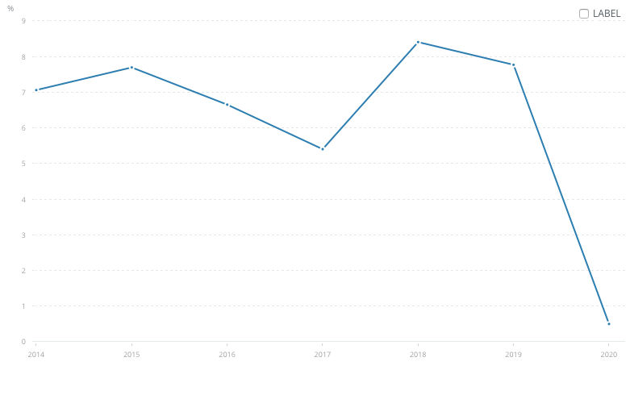
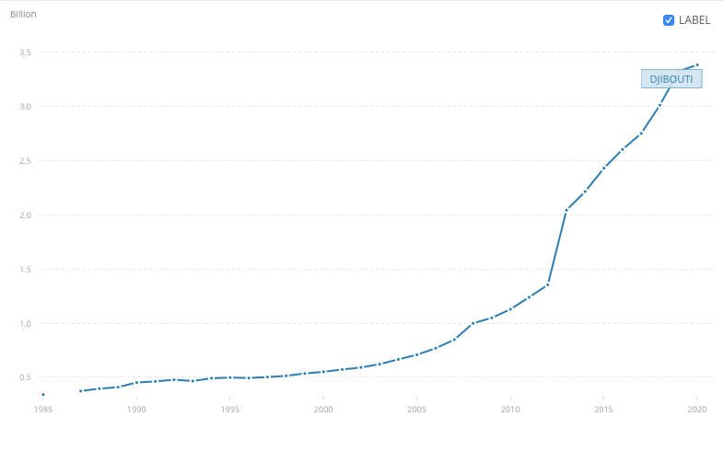
National Income and Growth [World Bank]
Annual GDP growth rate (shown on the left): 0.5%
Drastic change from 7.77% the year prior
Total GDP in current US$ (shown on the right): 3.384 Billion
US GDP for comparison: 20.953 Trillion
Steady positive growth
Source: “The World Bank in Djibouti.” World Bank, World Bank Group, https://www.worldbank.org/en/country/djibouti

Slide 5
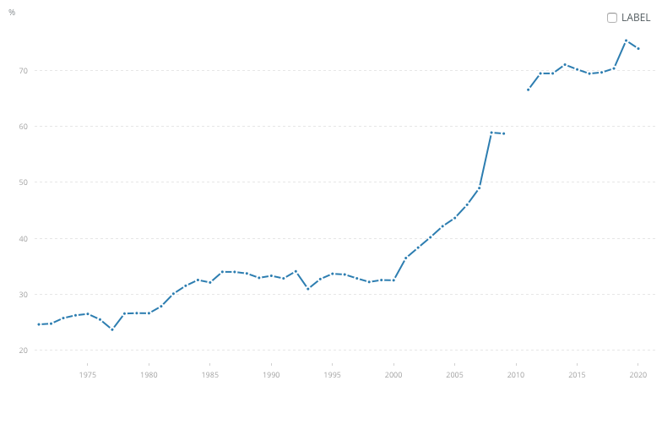
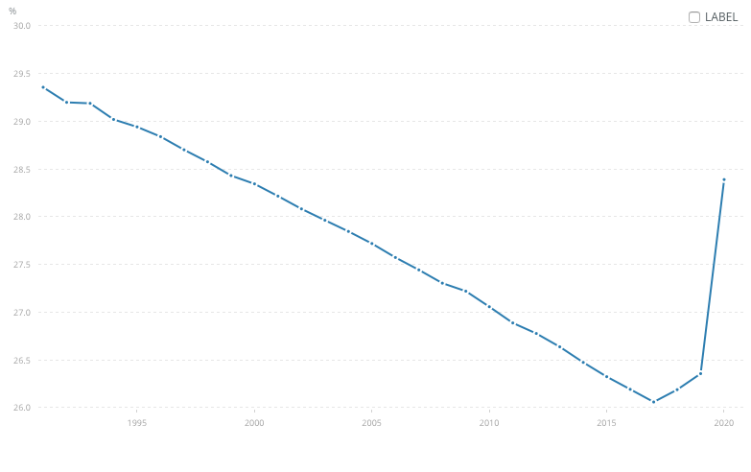
Labor Market Conditions [World Bank]
Population: 988,002
Constant rise
School enrollment (upper right): 73.85%
Steady incline from as low as 23% in the 70’s
Unemployment rate (lower right): 29.38%
Steady progressive decrease over last few decades
Drastic spike in unemployment observed with the influx of the pandemic
Source: “The World Bank in Djibouti.” World Bank, World Bank Group, https://www.worldbank.org/en/country/djibouti

Slide 6
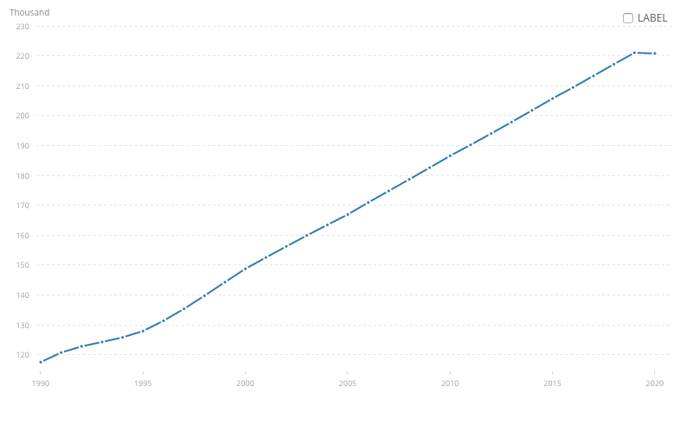
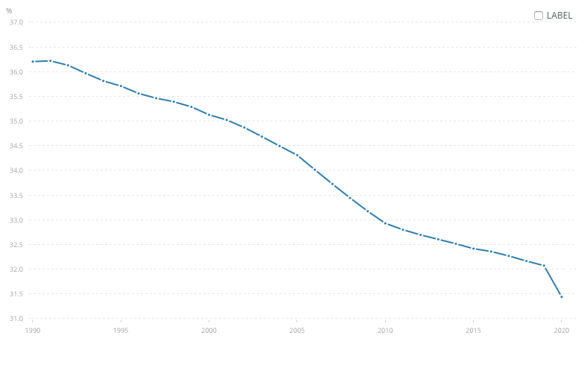
Labor Market Conditions [World Bank]
Labor Force (upper right): 220,818
Steady increase which correlates with population
Labor Force Participation Rate (lower right): 31.44%
In a constant decline
Dangerous drop in participation rate corresponding with the surge of the pandemic
Source: “The World Bank in Djibouti.” World Bank, World Bank Group, https://www.worldbank.org/en/country/djibouti

Slide 7
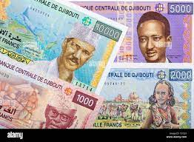
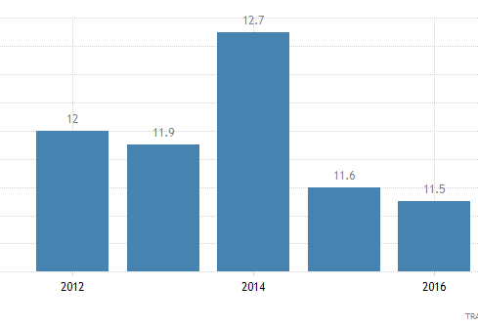
Money and Interest Rates
The national currency of Djibouti is the Djiboutian Franc (Fdj.).
Exchange rate to US$: 1 US dollar = 177.721 fdj [OANDA corporation]
Interest rate: 11.2% [Trading Economics]
Decrease from 11.5% the year prior
Still close to the all-time high of 12.7%
Deposit Interest rate: 1.65%
Sources: “Djibouti Indicators.” Trading Economics, TRADING ECONOMICS, 2022, https://tradingeconomics.com/djibouti.
“Djiboutian Franc.” OANDA, OANDA corporation, 2020, https://www1.oanda.com/currency/iso-currency-codes/DJF

Slide 8
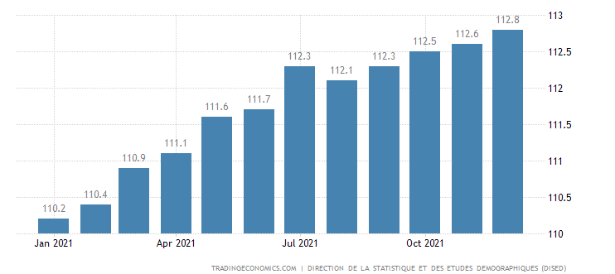
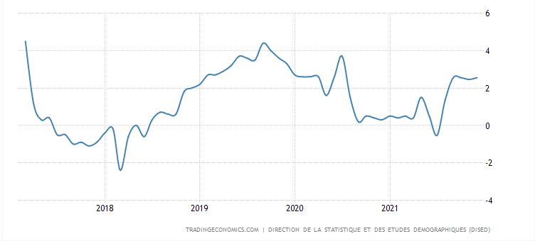
Price Level and Inflation [Trading Economics]
Consumer Price Index (upper right): 112.8
Inflation rate (lower right): 2.55%
Abnormally high due to as a result of the pandemic
Source: “Djibouti Indicators.” Trading Economics, TRADING ECONOMICS, 2022, https://tradingeconomics.com/djibouti.

Slide 9
References
“Djibouti Indicators.” Trading Economics, TRADING ECONOMICS, 2022, https://tradingeconomics.com/djibouti.
“The World Bank in Djibouti.” World Bank, World Bank Group, https://www.worldbank.org/en/country/djibouti.
“Djiboutian Franc.” OANDA, OANDA corporation, 2020, https://www1.oanda.com/currency/iso- currency-codes/DJF

